Slide 1
Fungal Cell Structure

Slide 2

In this Smart Lesson, you will be doing the following:
1. | Recalling that fungal cells are eukaryotic and belong to their own kingdom.
2. | Comparing and contrasting fungal cells with plant and animal cells.
3. | Explaining how fungi obtain the energy they need to survive.

Slide 3

What are fungi?
They are not just the most entertaining guy in your class, but a whole kingdom of organisms!

Slide 4


Slide 5

You may not have thought much about fungi before, but they make up a whole kingdom of life: kingdom Fungi. They are distinct organisms from both animals and plants.
Fungi are usually multicellular, like the mushrooms you might eat on top of pizza; but they can also be unicellular, like the yeast used to make the pizza base.

Slide 6
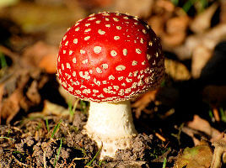
Fungi might look more like plants than animals, but their cellular structure is actually more like that of animals than plants!
Fungi are not plants, so they do not perform photosynthesis. They feed by decomposing materials (usually dead matter) outside their bodies and then absorbing the nutrients.

Slide 7
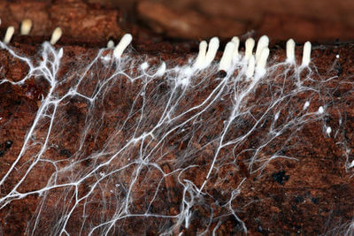
The main body of a fungus is called the mycelium, a large web made of small branching filaments called hyphae. The mycelium web can get incredibly large, with the largest fungus discovered so far occupying almost 10 square kilometres!
The mycelium is usually hidden in the soil, so you won't notice it until the fungus develops its fruiting bodies such as mushrooms, puffballs or truffles. These fruiting bodies are made so that the fungus can reproduce.

Slide 8


Slide 9
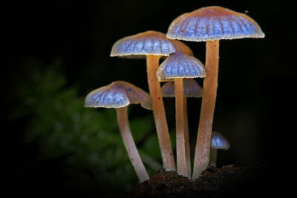
Like plant and animal cells, fungal cells are eukaryotic. They have a nucleus and other membrane-bound organelles.
The structure of fungal cells is different from both plant and animal cells, but there are similarities to both.

Slide 10
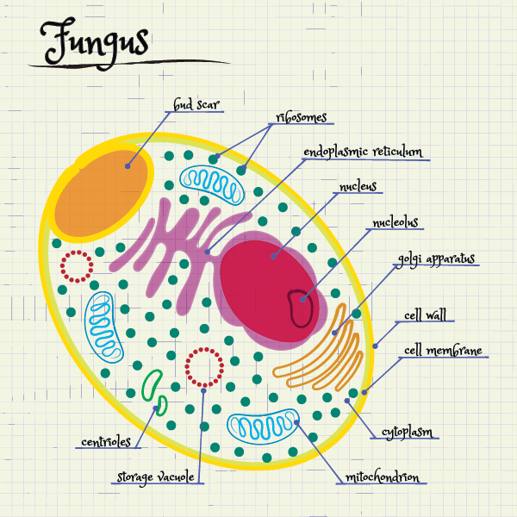
Fungal cells have all the organelles that animal cells have: a nucleus, ribosomes, mitochondria, Golgi apparatus, endoplasmic reticulum, cell membrane and cytoplasm.

Slide 11
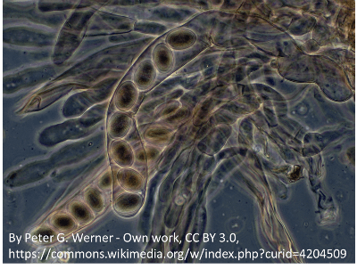
However, like plant cells, fungal cells have a strong cell wall. This gives the cell protection and structural support.

Slide 12
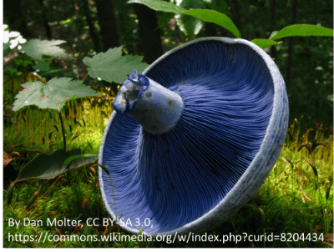
Fungal cell walls are different from plant cell walls.
Fungal cell walls are made up of a compound called chitin, which is the same compound that makes up the exoskeleton of insects. Plant cell walls are made up of cellulose.

Slide 13
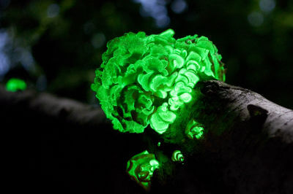
Unlike plant cells, fungal cells do not have a large central vacuole or chloroplasts. Fungi do not undergo photosynthesis, so they don't need chloroplasts.

Slide 14
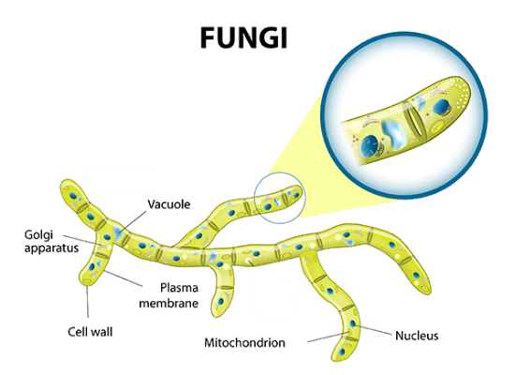
Remember: Fungi get the energy and nutrients they need by breaking down matter and absorbing it.
Fungal cells do this using enzymes (which are specialised molecules) that break down substances outside the cell. The nutrients and sugars are then absorbed into the cell.
Mitochondria in the fungal cells use absorbed glucose to produce ATP energy. Like animal cells, the glucose must come from outside the cell.

Slide 15
